Slide 1



CYBERGUARD SOLUTIONS
MEDSECURE HEALTH
SYSTEM PROJECT

Slide 2
CYBERGUARD SOLUTIONS
AGENDA
of our presentation
01.Welcome & Introduction (2 min)
05.Change Management Process (3 min)
02. Client background (2 min)
06. Cryptographic Solutions (3 min)
03. Security Control Analysis (4 min)
07. Summary and Key Takeaway (1 min)
04. Fundamental Security Concepts (4 min)
08. Q&A (1 min)

Slide 3

CYBERGUARD SOLUTIONS
Client Background
MedSecure Health Systems:
A healthcare provider managing sensitive patient data and critical healthcare infrastructure.
Importance of Cybersecurity in Healthcare:
  Protects patient confidentiality.
  Ensures data integrity.
  Maintains system availability and operational efficiency.

Slide 4
CYBERGUARD SOLUTIONS
Security Control Analysis
Preventive Controls:
Detective Controls:
Corrective Controls:
Preventive controls aim to stop security incidents before they occur. For MedSecure Health Systems, these include
  role-based access control (RBAC) to restrict data access,
  firewalls to block unauthorized network traffic, and
  encryption (AES-256 for data at rest, TLS/SSL for data in transit) to secure patient information.
Detective controls identify and detect security incidents swiftly. MedSecure employs
  Intrusion Detection Systems (IDS) to monitor network and host activities,
  Security Information and Event Management (SIEM) to analyze logs and provide alerts, and
  regular log and network traffic monitoring to catch anomalies early.
Corrective controls address and recover from security incidents, minimizing their impact. MedSecure's incident response plan outlines steps for managing breaches, supported by
  regular backups and recovery plan to ensure data restoration.
  Keeping systems updated through patch management and
  conducting root cause analysis help prevent future issues and enhance overall security.

Slide 5
CYBERGUARD SOLUTIONS
Fundamental Security Concepts
CIA Triad
Confidentiality:
Integrity:
Availability:
Ensures that patient data at MedSecure Health Systems is only accessible to authorized healthcare professionals, protecting sensitive patient information from unauthorized access or breaches.
Maintains the accuracy and consistency of patient records and medical data, ensuring that the information used for diagnosis and treatment remains reliable and unaltered by unauthorized parties.
Ensures that MedSecure's systems and patient data are accessible to healthcare providers whenever needed, supporting uninterrupted patient care and operational efficiency.

Slide 6
CYBERGUARD SOLUTIONS
Fundamental Security Concepts
AAA
Authentication:
Authorization:
Accounting:
Verifies the identity of healthcare professionals and staff accessing MedSecure's systems, ensuring that only legitimate users can access sensitive patient data and system functionalities.
Determines what medical records, systems, and resources each user can access based on their roles within MedSecure, ensuring that users have appropriate permissions aligned with their job responsibilities.
Tracks user activities within MedSecure's systems, maintaining logs and audit trails to monitor actions, detect suspicious behavior, and ensure compliance with healthcare regulations and policies.

Slide 7

CYBERGUARD SOLUTIONS
Fundamental Security Concepts
Zero Trust
  Principle:
Operates on the principle of "trust no one, verify everything" for MedSecure, meaning every access request to systems and data is thoroughly verified, regardless of whether it originates inside or outside the network.
  Application:
Implements strict access controls for MedSecure, continuously monitors network traffic for anomalies, and segments the network to minimize potential risks, ensuring robust protection for sensitive patient data and healthcare operations.

Slide 8
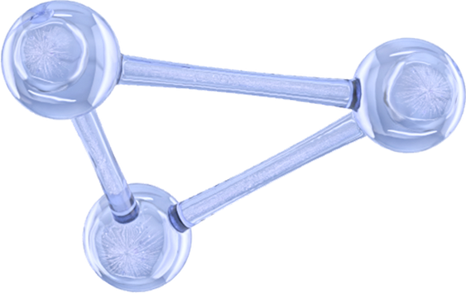

CYBERGUARD SOLUTIONS
Change Management Process:
A structured change management process ensures that changes to MedSecure Health Systems' IT environment are handled systematically and securely, minimizing disruptions to healthcare operations and maintaining the integrity of patient data.

Slide 9
CYBERGUARD SOLUTIONS
Proposed Process:
1
3
Change Request Submission:
Implementation and Testing:
Approved changes are implemented in a controlled environment. Thorough testing is conducted to ensure the change does not introduce new vulnerabilities or disrupt existing functionalities.
Detailed request forms are filled out by staff members proposing changes, ensuring all necessary information and justification for the change are documented.
2
4
Evaluation and Approval:
Documentation and Communication:
Each change request is assessed for potential risks and impacts on security, patient data, and system functionality. This evaluation is followed by formal approval from relevant stakeholders or a change management committee.
All changes are documented, including steps taken during implementation and test results. This documentation is updated in the change log and communicated to all relevant parties to ensure transparency and readiness.

Slide 10

CYBERGUARD SOLUTIONS
Proposed Process:
5
Post-Implementation Review:
After the change is implemented, a review is conducted to verify that it has achieved its objectives without adverse effects. Feedback is gathered to improve future change management processes.

Slide 11
CYBERGUARD SOLUTIONS
Cryptographic Solutions
AES-256: Used for securing patient data at rest, such as records stored in databases or on servers. This encryption ensures that even if data is accessed without authorization, it remains unreadable without the correct decryption key, protecting sensitive information from breaches.
TLS/SSL: Utilized for securing data in transit, such as information exchanged between healthcare providers and patients or within MedSecure’s IT infrastructure. TLS/SSL encryption protects data from being intercepted and read during transmission, maintaining patient confidentiality and regulatory compliance.
Encryption:
SHA-256: Employed to ensure data integrity by verifying that patient records or medical documents have not been altered. By comparing hash values, MedSecure can detect any unauthorized changes to critical data, ensuring the accuracy and reliability of patient information.
Hashing:
Authenticity and Integrity: Digital signatures are used to verify the authenticity of documents and communications, such as electronic prescriptions, medical orders, and other important documents. This ensures that these documents are signed by authorized personnel and have not been tampered with, providing trust and reliability in MedSecure’s digital communications.
Digital Signatures:

Slide 12
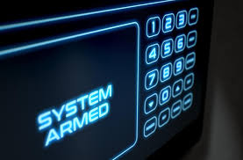
Summary
CYBERGUARD SOLUTIONS
In summary, our project for MedSecure Health Systems implemented vital security controls and concepts to safeguard patient data and operational continuity. We deployed preventive, detective, and corrective measures to fortify defenses against cyber threats. Key security principles such as the CIA Triad, AAA framework, and Zero Trust model were applied effectively in the healthcare context. Our structured change management process ensures secure IT changes, complemented by robust cryptographic solutions like AES-256 encryption, TLS/SSL, SHA-256 hashing, and digital signatures for comprehensive data protection. This integrated approach supports MedSecure in maintaining a secure environment for delivering uninterrupted, high-quality patient care.

Slide 13

CYBERGUARD SOLUTIONS
Q&A

Slide 14

CYBERGUARD SOLUTIONS
THANK YOU

